Slide 1
Tutorial for Mid-Term Exam 1
hy335a http://www.csd.uoc.gr/~hy335a/
Michalis Katsarakis katsarakis@csd.uoc.gr
13 November 2012

Slide 2
Exercise 1

Slide 3
Exercise 1
Α
d₁
Δ
d₂
Β
Δεδομένα
Distance: d₁, d₂
Bandwidth: b₁, b₂
Propagation Velocity: v
Max total delay: τ
Ζητούμενα
Packet size p, such that total delay $D≤τ$
D_{1,prop}
D_{1,trans}
D_{2,prop}
D_{2,trans}

Slide 4
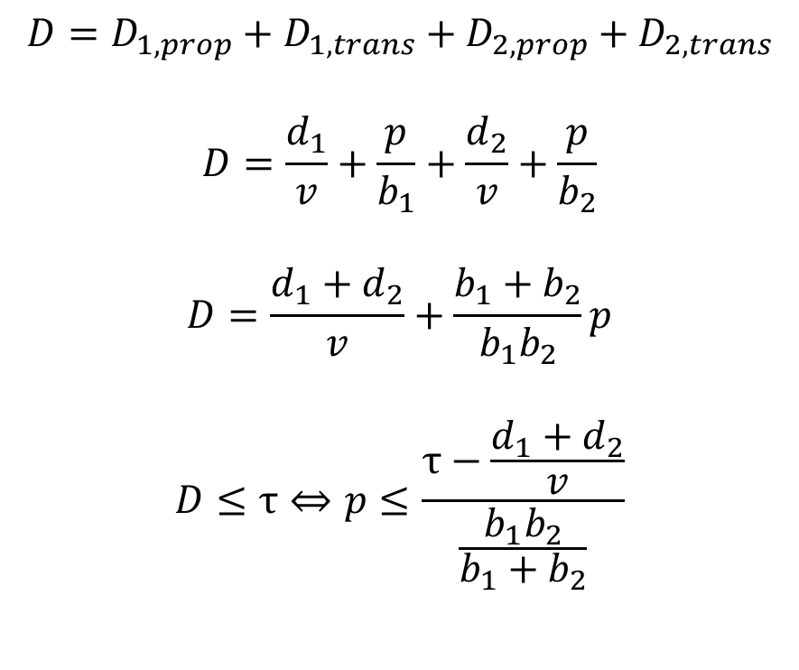
Exercise 1
Α
d₁
Δ
d₂
Β
D_{1,prop}
D_{1,trans}
D_{2,prop}
D_{2,trans}

Slide 5
Exercise 2

Slide 6
Exercise 2
Slot | Event | Retransmission Counter |  | Back off Interval |  | Back off duration
 |  | A | B | A | B | A | B
0 | A, B send -> collision | 1 | 1 | [0,1] | [0,1] | 0 | 0
1 | A, B send -> collision | 2 | 2 | [0,3] | [0,3] | 1 | 2
2 | A, B silent -> idle
3 | A send, B silent -> success | 0
4 | A silent, B send -> success |  | 0
A has no more data to send.
✓ Valid sequence of events.

Slide 7
Exercise 2
Slot | Event | Retransmission Counter |  | Back off Interval |  | Back off duration
 |  | A | B | A | B | A | B
0 | A, B send -> collision | 1 | 1 | [0,1] | [0,1] | 0 | 1
1 | A send, B silent -> success | 0
2 | A silent, B silent -> WRONG
A has no more data to send.
B should send immediately after its back off duration.
✗ Invalid sequence of events.

Slide 8
Exercise 3

Slide 9
Exercise 3
Attribute | Ethernet | Slotted Aloha | Token Passing | TDMA | FDMA
Collision Detection | ✓ | ✓
Carrier Sense | ✓
Exponential Back off | ✓
One host may use the entire capacity of the LAN | ✓ | ✓ | Delay to pass the token
Operates efficiently when few hosts (~ #channels) have simultaneously data to send |  |  | ✓ | ✓ | ✓
Vulnerable in the failure of a single host |  |  | ✓
Uses randomness to avoid synchronization | ✓ | ✓

Slide 10
Exercise 4

Slide 11
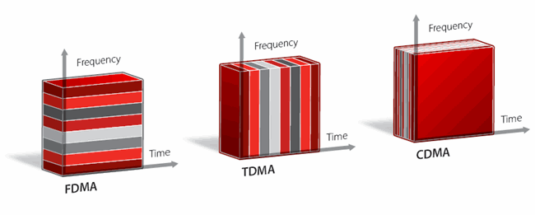
Exercise 4
…
Statistical
Multiplexing
Statistical Multiplexing
No resource reservation
Packets of different sources alternate in the link
Packets delivered asynchronously in a first-come first-serve fashion
Need for buffers
Packets need labels or addresses
The sequence of packets is proposed, based on the assumption that the likelihood of having multiple nodes sending data simultaneously and exceeding the link capacity is extremely small
Better link utilization
Efficient for bursty traffic

Slide 12
Πολυπλεξία FDM και TDM
FDM:
προσαρμόζει το σήμα στα χαρακτηριστικά του μέσου
παράδειγμα: μετάδοση τηλεόρασης
TDM:
κατάλληλο για σύγχρονη επικοινωνία
παράδειγμα: σταθερή τηλεφωνία, κινητή τηλεφωνία (GSM)
Κι οι δύο τεχνικές δεσμεύουν πόρους (συχνότητα ή χρονοθυρίδες) με στατικό τρόπο
Λόγω της στατικής δέσμευσης δεν είναι αποδοτικές για εκρηκτική κίνηση (bursty traffic)

Slide 13
Στατιστική πολυπλεξία (statistical multiplexing)
Διαίρεση χρόνου «κατ’ αίτηση»
Χρονοπρογραμματισμός συνδέσμου ανά πακέτο
Πακέτα από διαφορετικές πηγές εναλλάσσονται στον σύνδεσμο
Ζητήματα:
Τα πακέτα χρειάζονται ετικέτες (labels) ή διευθύνσεις (addresses)
☞ Απαιτείται η ενταμίευση πακέτων
 Μπορεί να συμβεί υπερχείλιση ενταμιευτών σε καταστάσεις συμφόρησης
…

Slide 14
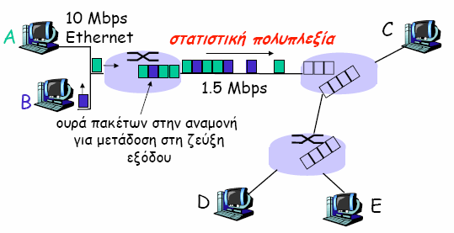
Μεταγωγή Πακέτων: Στατιστική Πολυπλεξία
Η ακολουθία πακέτων παράγεται από τις πηγές Α και Β με τυχαίο τρόπο → στατιστική πολυπλεξία
Στο TDM δίνεται σε κάθε κόμβο η ίδια χρονοθυρίδα (slot) στο περιστρεφόμενο πλαίσιο TDM

Slide 15
Exercise 5

Slide 16
Exercise 5
Packet loss causes
Attenuation
Path loss, multipath phenomena, shadowing
Interference
Network devices out of service
(e.g., power outage)
Misconfiguration
(e.g., wrong routing tables)
Collisions (concurrent transmissions in a link)
Congestion
In a link or in the receiver’s buffer

Slide 17
Exercise 6

Slide 18
Exercise 6
Application
Transport
Network
Link
Physical
Specific data communication on a process-to-process level (e.g., web browser - web server communication)
Handles host-to-host communication It has the notion of flow (e.g., sequence of packets to be transmitted from the source to the destination) and tries to provide some guarantees with respect to the quality of service for that flow.
Specifies the neighboring node to which a packet should be sent. Every router which receives this packet repeats the procedure and eventually the packet reaches its destination.
Handles communication between adjacent network nodes
Defines the means of transmitting raw bits over a physical link.

Slide 19
Exercise 6
Common Mistake:
Το επίπεδο μεταφοράς είναι υπεύθυνο ώστε η ροή των πακέτων να ικανοποιεί κάποια χαρακτηριστικά που αναφέρονται στην ποιότητα υπηρεσίας που χρειάζεται να υποστηριχτεί μεταξύ πηγής και προορισμού.
Το TCP εξασφαλίζει ότι το επίπεδο εφαρμογής δεν θα δει πακέτα σε λάθος σειρά και ότι δεν θα χαθούν πακέτα. Το UDP προσπαθεί να κάνει ότι καλύτερο μπορεί, χωρίς να εξασφαλίζει εγγυήσεις για την ποιότητα υπηρεσίας.
Application
Transport
Network
Link
Physical
Specific data communication on a process-to-process level (e.g., web browser - web server communication)
Handles host-to-host communication It has the notion of flow (e.g., sequence of packets to be transmitted from the source to the destination) and tries to provide some guarantees with respect to the quality of service for that flow.
Specifies the neighboring node to which a packet should be sent. Every router which receives this packet repeats the procedure and eventually the packet reaches its destination.
Handles communication between adjacent network nodes
Defines the means of transmitting raw bits over a physical link.
Common Mistake:
Δεν καθορίζει το μονοπάτι αλλά τον επόμενο κόμβο

Slide 20
Exercise 7

Slide 21
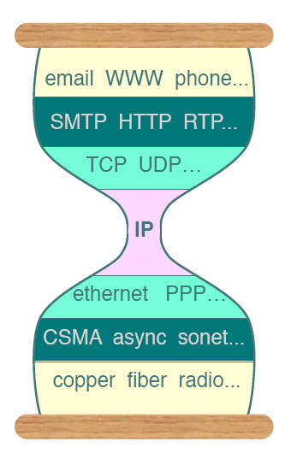
Exercise 7
Why layered architecture?
Larger network
Global addressing
Isolate protocols from network details/changes
Group communication functions into logical layers
What problems would face a flat architecture?
Poor Scalability
Difficult adoption of new technologies
Inability to change the implementation of specific functionality
No reuse of common functionalities among network applications

Slide 22
Exercise 8

Slide 23
Exercise 8
ARP: Address Resolution Protocol
Each IP node (Host, Router) on LAN has ARP table
ARP Table: IP-MAC address mappings for some LAN nodes < IP address; MAC address; TTL>
A wants to send datagram to B, and B’s MAC address not in A’s ARP table.
A broadcasts ARP query packet, containing B's IP address
B receives ARP packet, replies to A with its (B's) MAC address
A caches (saves) IP-to-MAC address pair in its ARP table until information becomes old (times out)
ARP is “self-learning”
nodes automatically discover adjacent nodes’ MAC addresses using broadcast messages
ARP is “plug-and-play”
nodes create their ARP tables without intervention from net administrator

Slide 24
ARP: Address Resolution Protocol [RFC 826]
How to determine
MAC address of B
knowing B’s IP address?
Each IP node (Host, Router) on LAN has ARP table
ARP Table: IP/MAC address mappings for some LAN nodes
< IP address; MAC address; TTL>
TTL (Time To Live): time after which address mapping will be forgotten (typically 20 min)
237.196.7.78
1A-2F-BB-76-09-AD
237.196.7.23
237.196.7.14
LAN
71-65-F7-2B-08-53
58-23-D7-FA-20-B0
0C-C4-11-6F-E3-98
237.196.7.88

Slide 25
ARP protocol: Same LAN (network)
A wants to send datagram to B, and B’s MAC address not in A’s ARP table.
A broadcasts ARP query packet, containing B's IP address
Dest MAC address = FF-FF-FF-FF-FF-FF
all machines on LAN receive ARP query
B receives ARP packet, replies to A with its (B's) MAC address
frame sent to A’s MAC address (unicast)
A caches (saves) IP-to-MAC address pair in its ARP table until information becomes old (times out)
soft state: information that times out (goes away) unless refreshed
ARP is “plug-and-play”:
nodes create their ARP tables without intervention from net administrator

Slide 26
Exercise 9

Slide 27
Exercise 9
Forwarding
The process of sending all bits of a packet to an adjacent node through the link which directly connects them
The process of guiding the encapsulation of an application layer message in packets of lower protocols, until it reaches the physical layer (and the reverse process, respectively).
Routing
The process of specifying the next node to which the packet should be forwarded, in order for it to eventually reach its destination

Slide 28
EXERCISE 10

Slide 29
Exercise 10
In a typical TCP/IP stack, error control is performed at multiple levels:
Ethernet frames carry a CRC-32 checksum. Frames with errors are discarded by the receiver hardware.
IPv4 headers contain a checksum protecting the header. Packets with errors are dropped within the network or at the receiver.
UDP has an optional checksum covering the payload and addressing information from the UDP and IP headers.
TCP provides a checksum for protecting the payload and addressing information from the TCP and IP headers.

Slide 30
Exercise 10
A protocol does not have access to the headers of the lower layer protocols
Problems are addressed locally, without retransmitting the packet throughout the entire path
Error correction may need data from previous packets
Increased delay and memory needs by low layer network devices, in order to run sophisticated algorithms

Slide 31
Exercise 10
Link layer retransmissions versus transport layer retransmissions
R₄
Host A
R₁
Host B
R₃
R₅
R₂
Bit errors happen here

Slide 32
EXERCISE 11

Slide 33
Exercise 11
32-bit IP address
Network layer address
Used to get datagram to destination IP subnet
New address assigned to the interface (manually or by DHCP server) every time it changes network
48-bit MAC address (for most LANs)
Link layer address
Used to get frame from one interface to another physically-connected interface (same network)
Burned in the interface ROM
A node may have more than one interface, each one having its own MAC and IP address

Slide 34
Exercise 11
Common Mistake
32-bit IP address
Network layer address
Used to get datagram to destination IP subnet
New address assigned to the interface (manually or by DHCP server) every time it changes network (not geographical region)
48-bit MAC address (for most LANs)
Link layer address
Used to get frame from one interface to another physically-connected interface (same network)
Burned in the interface ROM
A node may have more than one interface, each one having its own MAC and IP address

